Slide 1
Apple Products
By Kabeer
Evan
Cole and Shane

Slide 2
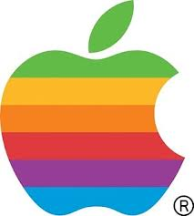
About Apple
Apple was founded on April first 1976 and was incorporated January third 1977. The founders are Steve Jobs, Steve Wozniak and Ronald Wayne.
Tim Cooke is the C.E.O.
They have 395 stores.
Apple is worth about 626 billion US dollars.
They have 72,800 employees.

Slide 3
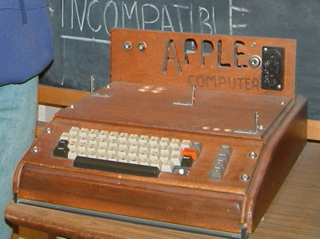
The Beginning
Apple's first product, was sold as an assembled circuit board and lacked basic features such as a keyboard, monitor, and case. The owner of this unit to the right added a keyboard and a wooden case.

Slide 4
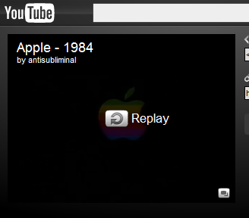
Macintosh
In 1984, Apple next launched the Macintosh. Its debut was announced by the now famous $1.5 million television commercial "1984". It was directed by Ridley Scott and was aired during the third quarter of Super Bowl XVIII on January 22, 1984. It is now hailed as a watershed event for Apple's success and a "masterpiece".

Slide 5
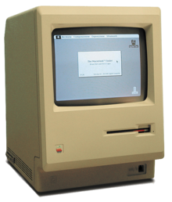
Macintosh
The Macintosh initially sold well, but follow-up sales were not strong due to its high price and limited range of software titles.
The machine's fortunes changed with the introduction of the LaserWriter, the first PostScript laser printer to be offered at a reasonable price, and PageMaker, an early desktop publishing package.
It has been suggested that the combination of these three products was responsible for the creation of the desktop publishing market.
The Mac was particularly powerful in the desktop publishing market due to its advanced graphics capabilities, which had necessarily been built in to create the intuitive Macintosh GUI.

Slide 6
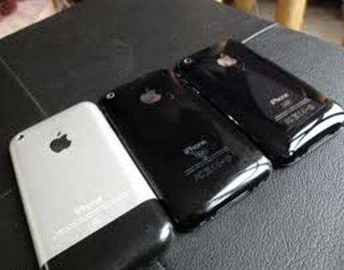
IPhone
This is only the beginning."
"Touch it."
"Apple reinvents the phone."
"Say Hello to iPhone."

Slide 7
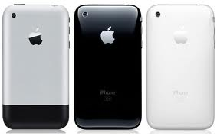
iPhone
The iPhone (retroactively labeled the original iPhone, iPhone 1 or iPhone 2G) is a smartphone that was designed and marketed by Apple Inc.
-It was introduced in the United States on June 29, 2007. It featured quad-band GSM cellular connectivity with GPRS and EDGE support for data transfer.
-The original iPhone's design was centered on a 3.5 inches (89 mm).
-The combined metal and plastic rear is unique to the original iPhone.

Slide 8
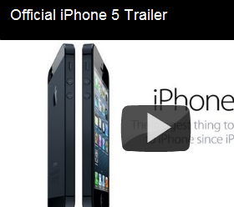
iPhone 5
The iPhone 5 is a touchscreen-based smartphone
It is the sixth generation of the iPhone and succeeds the iPhone 4S. Apple held an event to formally introduce the phone on September 12, 2012.
It is made by apple
They sold 5 million phones in the first 3 days it was sold.

Slide 9
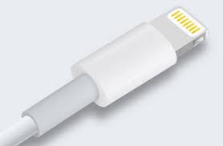
New IPhone 5 charger
the iPhone 5 has a new charger that solves most problems…with the new charger some of the features are that .it I double sided so it doesn’t matter what side you plug it into your phone and it is very slim.
The iPhone 5features a new dock connector named Lightning, which replaces the old 30-pin Apple Dock connector. The Apple Lightning connector has eight pins and all signaling is digital. This new connector is smaller than the previous one, helping the iPhone 5 to be slimmer than its predecessors.

Slide 10
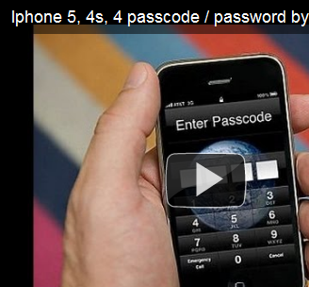
Glitch to get past the passcode
This is a glitch that lets you get past the passcode a see peoples contacts.
This does not work with ios 6.
We tried it with ios 6 and it completely messes up your phone and you have to shut off your phone.

Slide 11
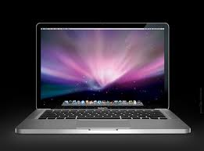
Mac
- in a survey taken in the use out of 22,000 creative firms 77 percent of them planed to purchase mac/ apple computers
- More than 57% of Web sites that use video use Apple's
QuickTime to deliver it.
-On average, the cost to develop and support Windows applications is 50% higher per dollar of revenue than the cost to develop for Macintosh.
-Mac users are 50% more accurate and 44% more productive than Wintel users.
-20% of all the personal computers in use today are Macs.
- In 2000, Apple captured an 18.2% share of the U.S. education portable market.
-Macintosh software comprises over 18% of all software sold.
-Apple computers account for 15% of CompUSA's CPU sales.

Slide 12
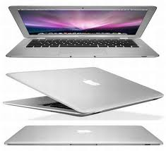
mac
CNN rated the Apple iBook "Best New Laptop" of 2001.
-Apple recently closed the single largest educational sale ever: 23,000 iBook's.
-Apple was the best performing computer stock in 1998, passed Microsoft in price in 1999, and split 2-for-1 in summer of 2000
-Apple Computer has been profitable 14 of the last 15 quarters.
(7/17/2001)
-apple is one of only two major PC companies that's still making money during this slump.
-Apple's market share is greater than that of Sony televisions, Tag Heuer watches, and the COMBINED shares of ALL European passenger cars sold in the U.S., including Mercedes, BMW, Volvo, Jaguar, and Porsche.
(Appliance Manufacturer & Market Data Book of Automotive News,
-The Apple iMac is the best-selling computer in CompUSA's 13-year history.

Slide 13
mac
(Appliance Manufacturer & Market Data Book of Automotive News,
-The Apple iMac is the best-selling computer in CompUSA's 13-year history.
-As of March 1999, Apple continues to lead in K-12 computer purchases.
-Apple Computer holds more than twice as many
-The Apple iMac is the best-selling computer in CompUSA's 13-year history.
-As of March 1999, Apple continues to lead in K-12 computer purchases.
-Apple Computer holds more than twice as many computing patents than does Microsoft.
-As of March 1999, Apple continues to lead in K-12 computer purchases.
-Apple Computer holds more than twice as many computing patents than does Microsoft.

Slide 14
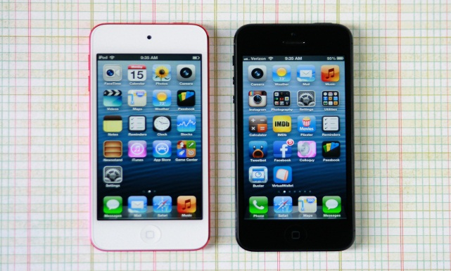
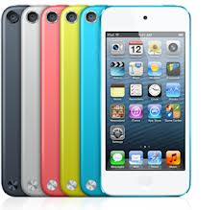
The iPod touch
Original release date: September 14, 2007. 2nd generation : September 9, 2008 (8 GB only). Third generation: September 9, 2009. Fourth generation: Black: September 1, 2010 White: October 12, 2011. Fifth generation: October 15, 2012.
The iPod Touch runs ios.
Camera: hd video recording 1080p up to thirty frames/s with audio.
Face time was brought in with the fourth generation. It allows you to talk face to face on screen. It is hd and has audio to make like a real conversation.
They gave the fifth generation a panorama able camera to catch all the images around you.
82 million units were sold since September 2007.

Slide 15
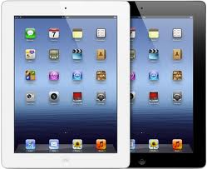
ipad
Ipad release date 1st generation: April 3rd 2010
2nd generation: March 11 2011
3rd generation: March 16th 2012
4th generation: November 2nd 2012

Slide 16
ipad
The ipad is a line of tablet computers developed and marketed by apple.
There are five generations of the ipad.
The fifth generation is the ipad mini which has a smaller screen.
The storage options are 16, 32, and 64.
100 million units have been sold.

Slide 17
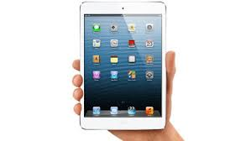
Ipad mini
-the apple ipad mini was finished October 23,2012.
-it was the fifth major release for apple.
-speculation for the Ipad mini started as early as April 2012.
it was released November 2 2012.
-the ipad mini was released with ios 6.
-it also has the new lightening connecter same as the iPhone 5.

Slide 18
Bibliography
For the passcode glitch video http://www.youtube.com/watch?v=vbJksp5HqNw
For the Macintosh commercial http://www.youtube.com/watch?v=R706isyDrqI\
The iPhone features http://www.youtube.com/watch?v=xNsGNlDb6xY
And wiki for a lot of the information.

Slide 19
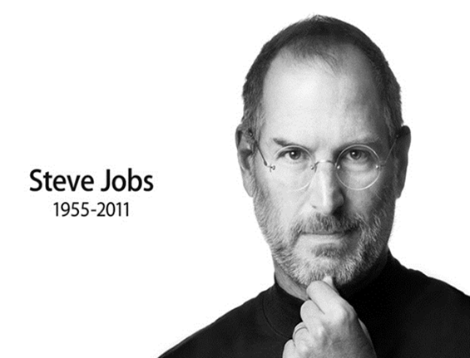
Steve jobs
He was the founder and CEO of apple INC.
February 24,1955 -October 5, 2011

